Slide 1

Monte Carlo Simulation of Emergency Response for City Planning
Group Members:
Yashas Prashanth
Pranav Sekhar
Shruti Ravichandran

Slide 2
Introduction
Simulate randomized emergencies in a custom city
City can be configured to have emergency response units at specific locations and of specific sizes
Optimal emergency unit(s) determined to respond to an emergency by the program
Objective: Minimize emergency response time
Each run of simulation represents a span of one day
Optimal emergency response unit locations & sizes can be determined through experimentation using set configurations
Notes:
Randomizing the time as a distribution of the population, which is multiplied by a scaling factor according to time of the day. From

Slide 3
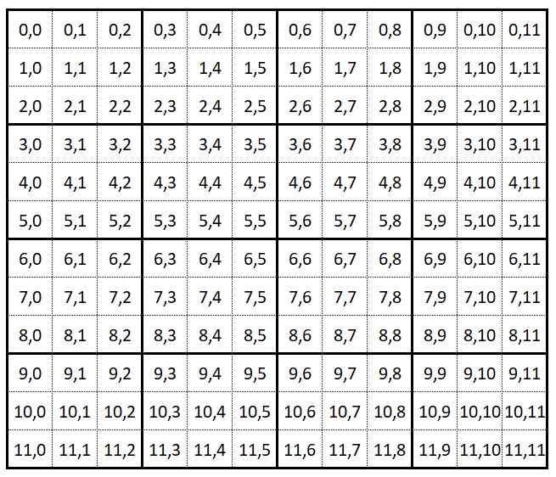
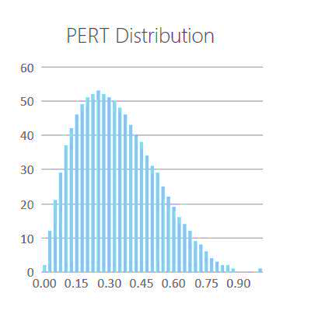
City Configuration
Configurable Parameters
Assumptions
Configurable Parameters
Each City is divided into zones with equal areas
Every zone can have a different population which will be uniformly distributed within a zone
There is a path between all horizontally & vertically adjacent coordinates
Height of the city (in terms of zones)
Width of the city (in terms of zones)
Population of each zone
Random Variables
Random Variables
Traffic: Randomized based on zone population, scaled by time of the day
Modeled using PERT Distribution
Traffic: Randomized based on zone population, scaled by time of the day
Modeled using PERT Distribution
Zone
Height = 4
% increase in Default Commute Time
% increase in Default Commute Time
Traffic = Default Time * (1 + randomized traffic penalty * deterministic time scaling value)
Width = 4
Notes:
Randomizing the time as a distribution of the population, which is multiplied by a scaling factor according to time of the day. From

Slide 4
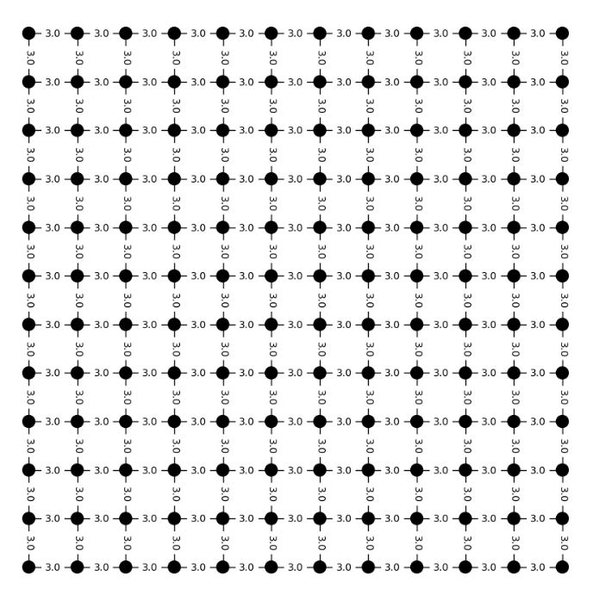
City Configuration
Node: Coordinates in the city
Edges: Road between coordinates of the City
Edge Attribute: Commute Time between Nodes
Note
A coordinate represents the area around its vicinity, not a single point in the city.
Emergencies will occur at a graph node
Emergency Units are also located on graph nodes
Hence, an emergency can occur on a coordinate that houses an Emergency Response Unit
Notes:
Randomizing the time as a distribution of the population, which is multiplied by a scaling factor according to time of the day. From

Slide 5
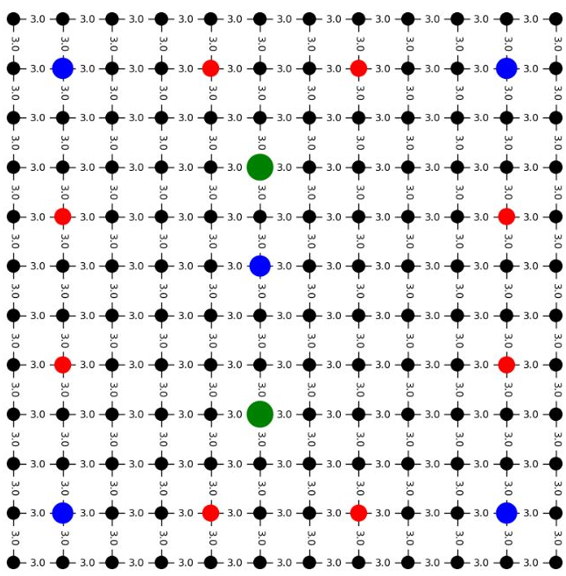
Emergency Units Configuration
Small Emergency Response Unit – 3 Teams
Medium Emergency Response Unit – 5 Teams
Large Emergency Response Unit - 7 Teams
Configurable Parameters
# Small, # Medium and # Large Emergency Units
Position of each emergency unit as city coordinates
Notes:
Randomizing the time as a distribution of the population, which is multiplied by a scaling factor according to time of the day. From

Slide 6
Emergency
Randomized Variables: Time, Location, and Intensity of Emergency
Assumptions
Emergency Intensity | # Teams | Time to Resolve
1 (least intense) | 3 | 5 mins
2 | 4 | 10 mins
3 | 5 | 15 mins
4 | 6 | 20 mins
5 (most intense) | 7 | 25 mins
1k | 2k | 4k | 3k | 1k | 1k | 2k | 4k | 3k | 1k | 1k | 2k | 4k | 3k | 1k | 5k
Emergency rate for each zone
Poisson probability of emergency occurring for each zone
Random number generated for each zone
Configurable Parameters
0 | 0 | 0 | 0 | 0 | 0 | 0 | 0 | 0 | 1 | 0 | 0 | 0 | 0 | 0 | 0
Probability of Occurrence for each Emergency Intensity
Rate of Emergency
Randomly pick coordinate of emergency in Zone 9 – uniform distribution
Intensity of emergency randomly picked based on configured input probabilities
Base Rate of Emergency was derived from 911 calls dataset from Montgomery County PD obtained from montcoalert.org
Notes:
Randomizing the time as a distribution of the population, which is multiplied by a scaling factor according to time of the day. From

Slide 7
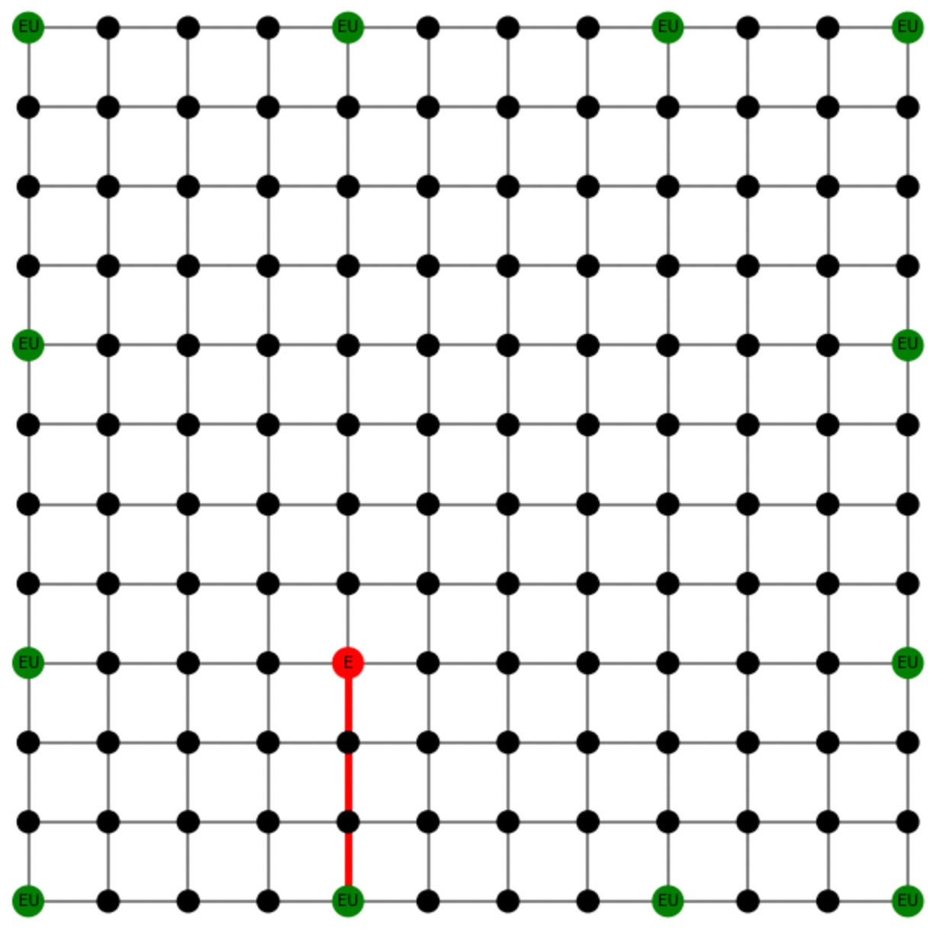
Emergency
Emergency is generated
Get list of all units with available teams
Sort units by proximity to emergency location (Shortest Distance using Dijkstra’s algorithm)
Allocate required #teams from one or more nearest units
Allocate required #teams from one or more units
Keep teams busy: to & fro commute time + resolution time
Make teams available
Emergency is successfully responded to if response time is within 10 minutes
Record commute time to emergency as Response Time
Emergency location
Emergency Response Unit Location
Emergency Response threshold of 10 mins has been determined based on this source
Notes:
Randomizing the time as a distribution of the population, which is multiplied by a scaling factor according to time of the day. From

Slide 8
Demo Time!

Slide 9
Questions?

